Slide 1
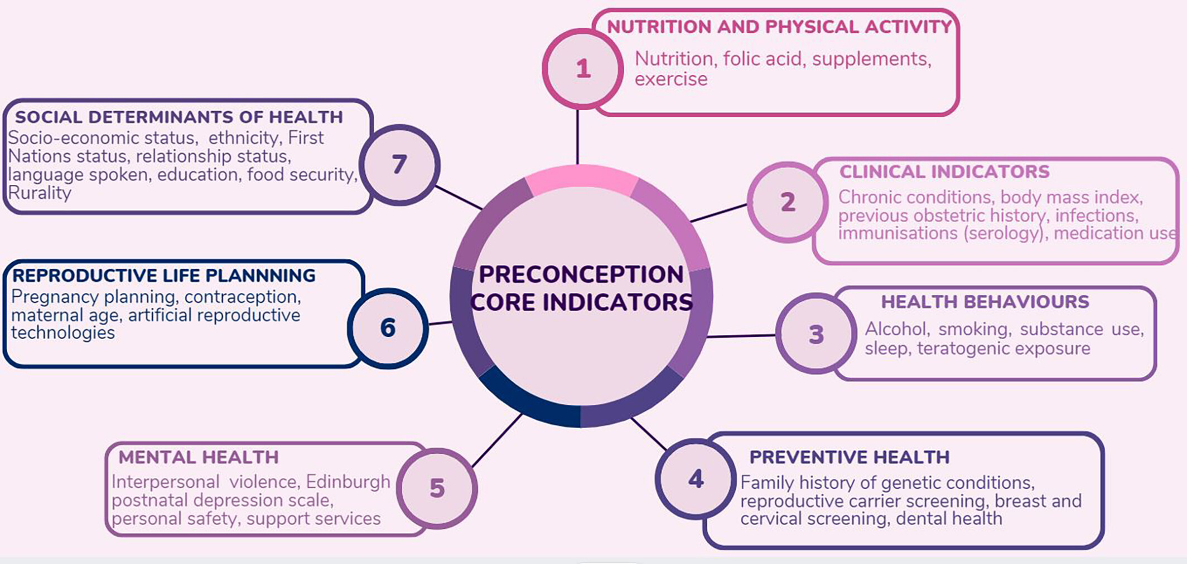
Assessing preconception health in Australia to support better outcomes in the first 2000 days – A critical need for building a core indicator framework
Aust NZ J Obst Gynaeco, Volume: 64, Issue: 5, Pages: 514-518, First published: 20 April 2024, DOI: (10.1111/ajo.13815)
Notes:
Preconception health core indicators developed across seven health domains.
IF THIS IMAGE HAS BEEN PROVIDED BY OR IS OWNED BY A THIRD PARTY, AS INDICATED IN THE CAPTION LINE, THEN FURTHER PERMISSION MAY BE NEEDED BEFORE ANY FURTHER USE. PLEASE CONTACT WILEY'S PERMISSIONS DEPARTMENT ON PERMISSIONS@WILEY.COM OR USE THE RIGHTSLINK SERVICE BY CLICKING ON THE 'REQUEST PERMISSIONS' LINK ACCOMPANYING THIS ARTICLE. WILEY OR AUTHOR OWNED IMAGES MAY BE USED FOR NON-COMMERCIAL PURPOSES, SUBJECT TO PROPER CITATION OF THE ARTICLE, AUTHOR, AND PUBLISHER.

